Slide 1
CALIFORNIA HOUSE PRICING PREDICTION PROJECT
NAME: CYNTHIA OBALA
ADMISSION NO: 21-2179

Slide 2
Importing the libraries
import numpy as np
import pandas as pd
import matplotlib.pyplot as plt
%matplotlib inline
import seaborn as sns
from sklearn.model selection import train test split
from sklearn.preprocessing import Standard Scaler
from sklearn.linear model import Linear Regression
from sklearn.ensemble import Random Forest Regressor
from sklearn.model selection import Grid Search CV

Slide 3
Data Information
The range index of the data is 20640 entries and has a total of 10 columns hence (20640,10) rows and columns.
All the columns of the data types are float64(longitude, latitude, housing median age, total rooms, total bedrooms, population, households, median income and median house value) except one column that is an object(ocean proximity)

Slide 4
Unique Data
This gives the non-repeated data sets.
They are always arranged in order as follows:
Households
Housing median age
Latitude
Longitude
Median house value
Median income
Ocean proximity
Population
Total bedrooms
Total rooms

Slide 5
Size of the set
In finding the size of a data set, we use Len.
The size of the data is 20640.
The size of the unique is 10.
This was a result of:
Len(data)=20640
Len(data)=10

Slide 6
Observation
When printing the housing head, the median house value decreases and the ocean proximity reads near bay while when printing the housing tail, the median house value is not always constant it increases and decreases. The ocean proximity reads inland.
Median house values are continuous hence a regression problem.
Since the range index was 20640 entries in every column except for the column with total bedrooms which had 20433 entries, when the non-entry is dropped and True is in placed all the range index will have same entries which is 20433.

Slide 7
Getting the Outliers
In order to get the outliers, we use describe to generate some summary statistics.
 | Total rooms | Median house value
Count | 20640.000000 | 20640.000000
mean | 2635.763081 | 206855.816909
std | 2181.615252 | 115395.615874
min | 2.000000 | 14999.000000
25% | 1447.750000 | 119600.000000
50% | 2127.000000 | 179700.000000
75% | 3148.000000 | 264725.000000
max | 39320.000000 | 500001.000000

Slide 8
Continuation…
Generating statistics helps us determine whether or not the data set has outliers.
In the table above, the observation made is that:
The total rooms and median house value columns have outliers. This is because the maximum total rooms is 39320.000000 with its mean being 2635.763081. This means that the mean is sensitive to the outlier but the fact that the mean is so small compared to its maximum value indicates the maximum value is an outlier similarly to the median house value.

Slide 9
Basic exploration of numeric features
First split the data set into train and test data set in order to estimate different parameters or to compare different model performance.
Then join both the x train and y train data in order to analyze basic correlation.
Exclude ocean proximity then plot a heat map to visualize the correlation matrix.
Observation made as per the heat map below:
Median income correlates highly with median house value therefore it can be a greater prediction for house price value.

Slide 10
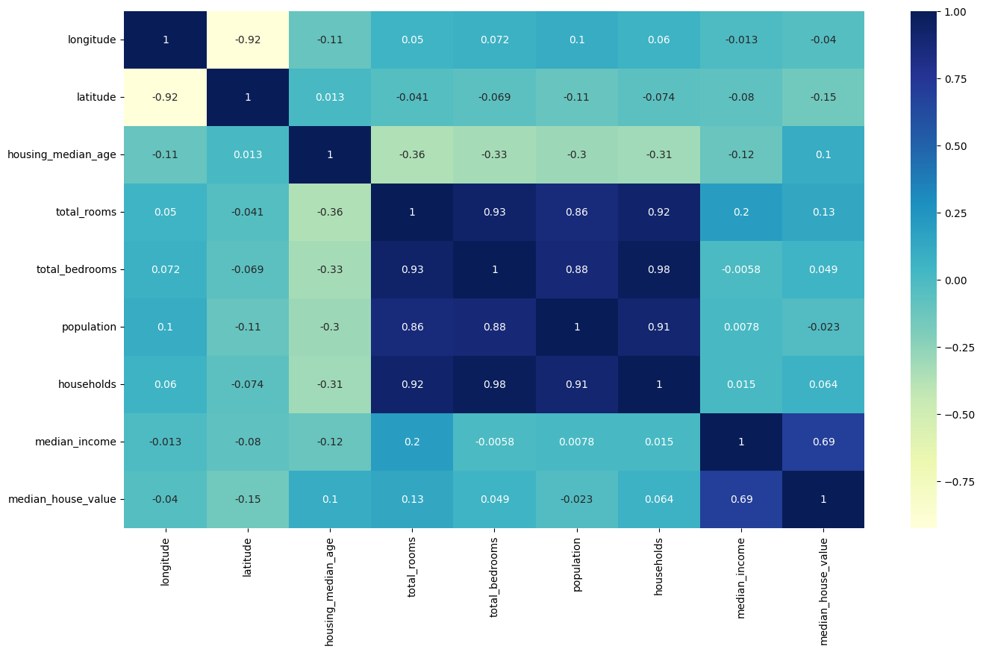
Continuation…..

Slide 11
Continuation…
 | Longitude | Latitude | Housing median age | Total rooms | Total bedrooms | Population | Households | Median income | Median house value
Median income | -0.013 | -0.08 | -0.12 | 0.2 | -0.0058 | 0.0078 | 0.015 | 1 | 0.69
Median house value | -0.04 | -0.15 | 0.1 | 0.13 | 0.049 | -0.023 | 0.064 | 0.69 | 1

Slide 12
Continuation…
Convert ocean proximity into numerical value.
Turn into binary features either 0 or 1.
Join with the train data since we turned it into multiple features.
Plot a heat map to see how the values correlate.
Observation made as per the heat map below:
Median house value has a negative correlation with inland meaning you pay less while has a higher positive correlation with <1 hour ocean compared to the island, near bay and near ocean making the price to be higher.

Slide 13
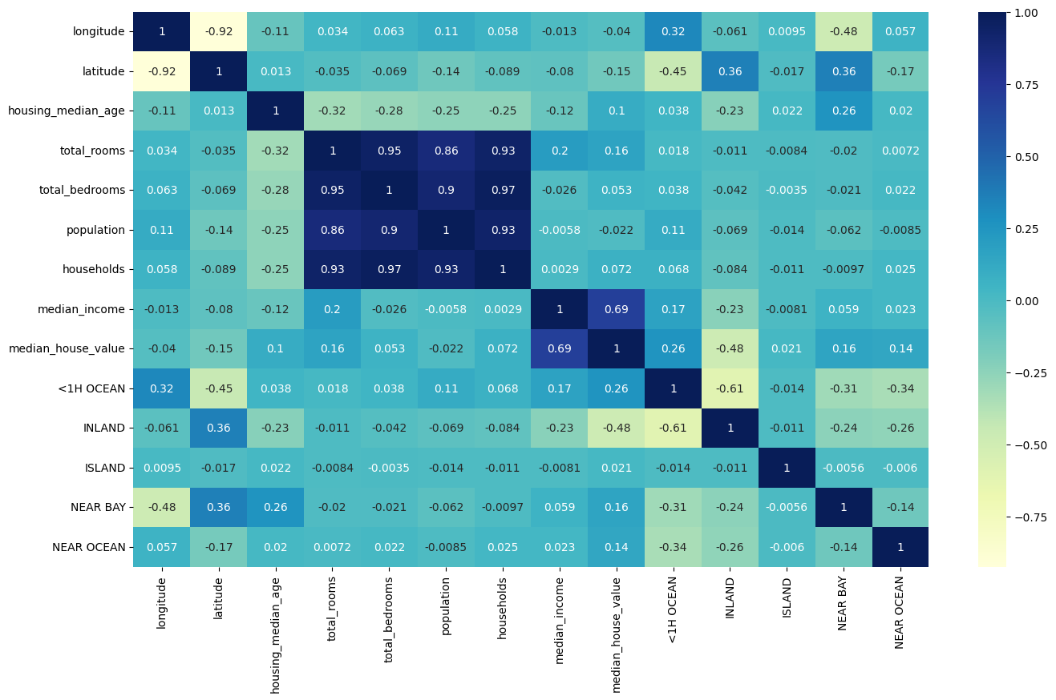
Continuation…

Slide 14
Continuation…
 | Longitude | latitude | Housing median age | Total rooms | Total bedrooms | population | households | Median income | Median house value | < 1 hour ocean | inland | island | Near bay | Near ocean
Median house value | -0.04 | -0.15 | 0.1 | 0.16 | 0.053 | -0.022 | 0.072 | 0.69 | 1 | 0.26 | -0.48 | 0.021 | 0.16 | 0.14

Slide 15
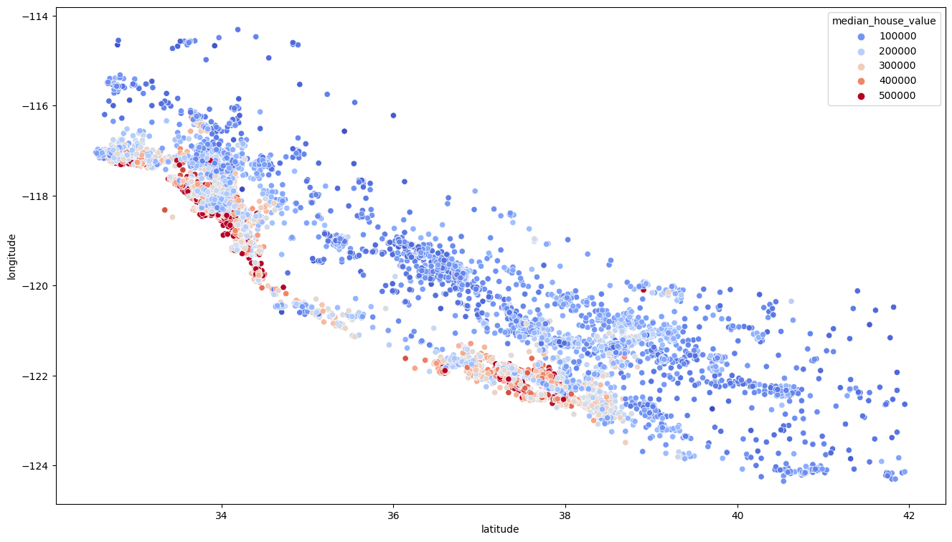
Continuation…
Plot a scatter plot

Slide 16
Continuation…
Observation on the scatter plot above:
The more blue it gets the less expensive the house and the more red it gets the more expensive the house.

Slide 17
Perform Linear Regression
This is done on training data by initiating the linear regression and fitting the model to the training data, through this we learn the coefficients.
Predict on the test data and if the result is bad or worse, apply scaler for optimum modal result since it standardizes the data values into a standard format.
Result is as follows:
reg score(x train, y train)
=0.674901906726037

Slide 18
Perform Grid Search CV
In order to get the best set of hyperparameter.
It is also a technique for finding the optimal parameter values.
Uses random forest regressor as its estimator.
Result as follows:
Best forest=grid search. best estimator
Best forest score (x train, y train)
=0.9688911972746963

Slide 19
Perform Random Forest Regression
Since it is one of the most accurate learning algorithms available and produces a highly accurate classifier for data sets.
Result as follows:
forest fit(x train, y train)
forest score(x train, y train)
=0.9746610301941195

Slide 20
Conclusion
From the above, it is clear that random forest accuracy is 0.9746610301941195 which is 97.47%. So Random Forest Regressor is a suitable model for predicting the price of a house.
Assumptions made:
Highly unbalanced and skewed data.

